Slide 1
Cloud computing fundamentals

Slide 2

requirement
I want to setup a global business, across the globe.

Slide 3

My issue
I don’t have budget(limited money)

Slide 4


Slide 5

Do you think it’s one person problem
No, multiple people are facing same issue

Slide 6
Should they stop?
No, Continue your business with one country

Slide 7
Problem if I am running business with one place
Suppose, I am driving my business . Lets say India for example. Now multiple people are facing latency issue.
As per Design principle latency should be minimal. Ideally 0

Slide 8
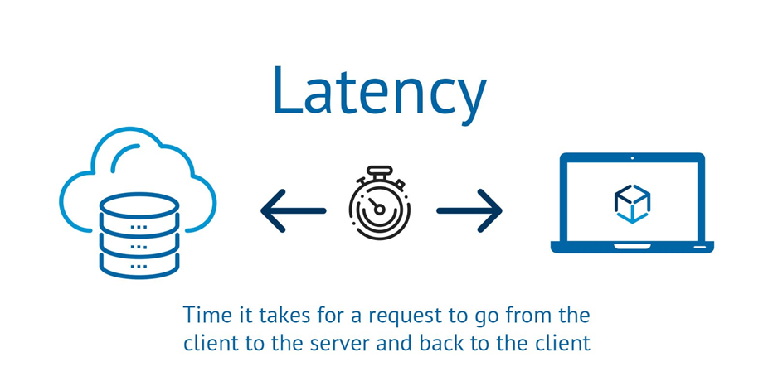
What is latency?

Slide 9
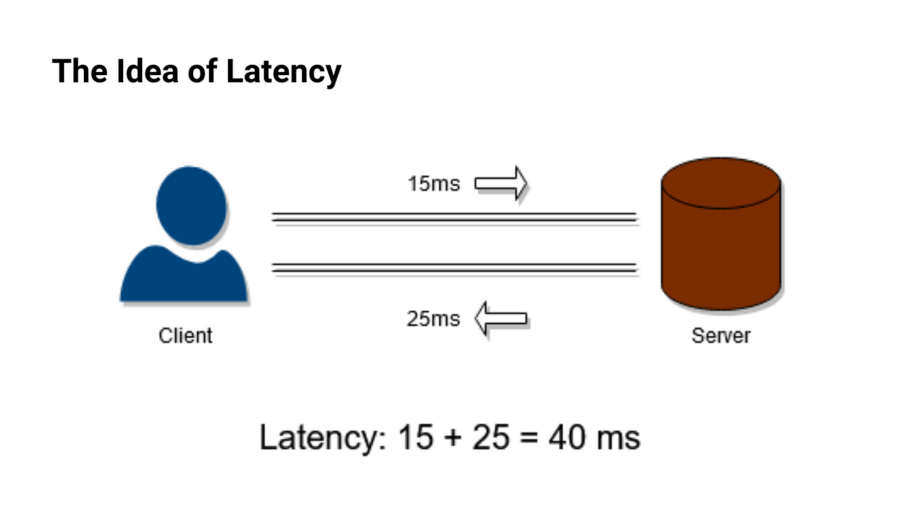

Slide 10

Are you joking?
Is it really possible to have latency?

Slide 11
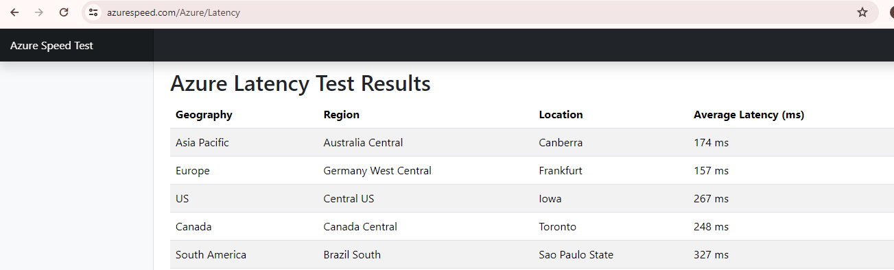
Latency calculator azure
Azure: https://www.azurespeed.com/Azure/Latency

Slide 12
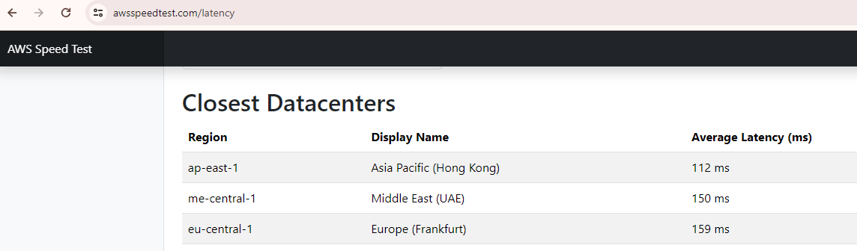
Latency calculator aws
Link: https://awsspeedtest.com/latency

Slide 13
How cloud provider solved this problem?
They invested huge amount and created large infrastructure, so now everyone can have business in major of the countries without latency.

Slide 14
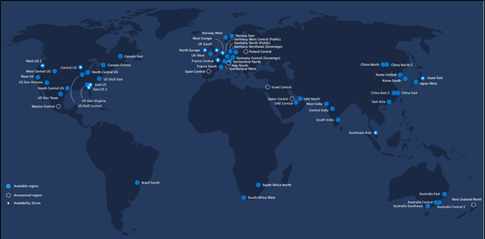

Slide 15
Business model of cloud provider?
Renting the servers on pay per use basis across the globe.

Slide 16
Cloud computing
CSP[Cloud service provider] Renting infrastructure across the globe and providing compute, storage, networking and database solutions.

Slide 17
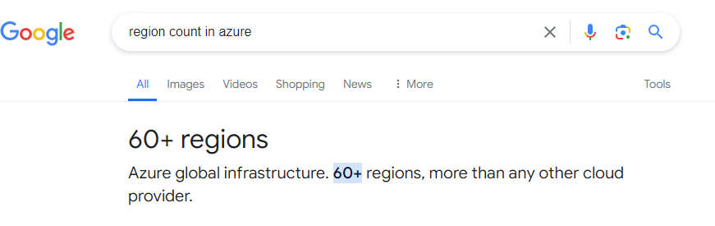
background
In the world we have approx. 195 countries, so many of them are not business oriented country, so cloud providers has created data center access multiple countries.

Slide 18
What is region?
It’s a physical location where server’s are physically installed. Referred as data centre
Note: We can select region while doing any activity.

Slide 19
Cloud promise
Cost optimization by 70%

Slide 20
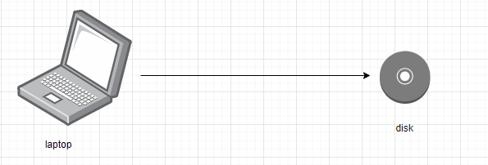
Case study: saving backup in disk drive

Slide 21
Unfortunate condition
My laptop was having some issue, so I formatted it, and I was thinking
That I will restore my things from my drive, but drive is having some virus.

Slide 22
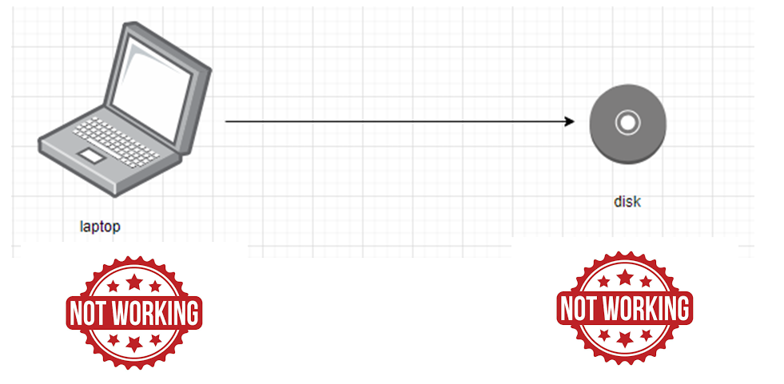
Case study: saving backup in disk drive

Slide 23

My condition now

Slide 24
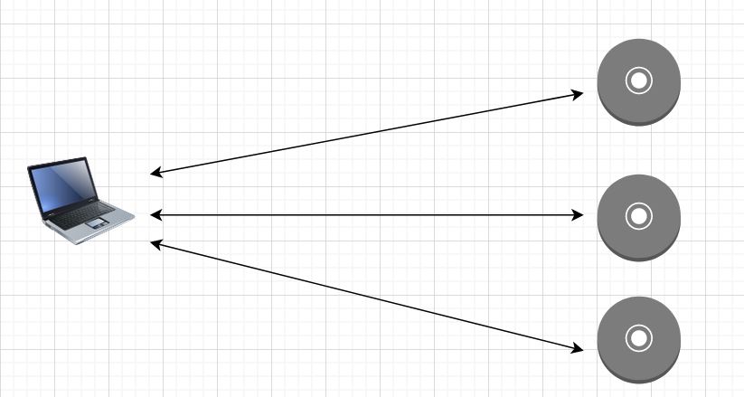
Saving data in 3 place

Slide 25
Saving data in 3 places
Storage cost= storage cost *3

Slide 26
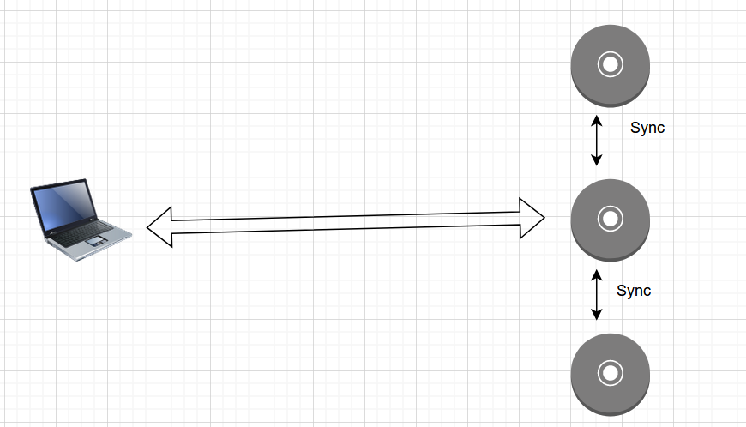
Cloud way to deal with this failure

Slide 27
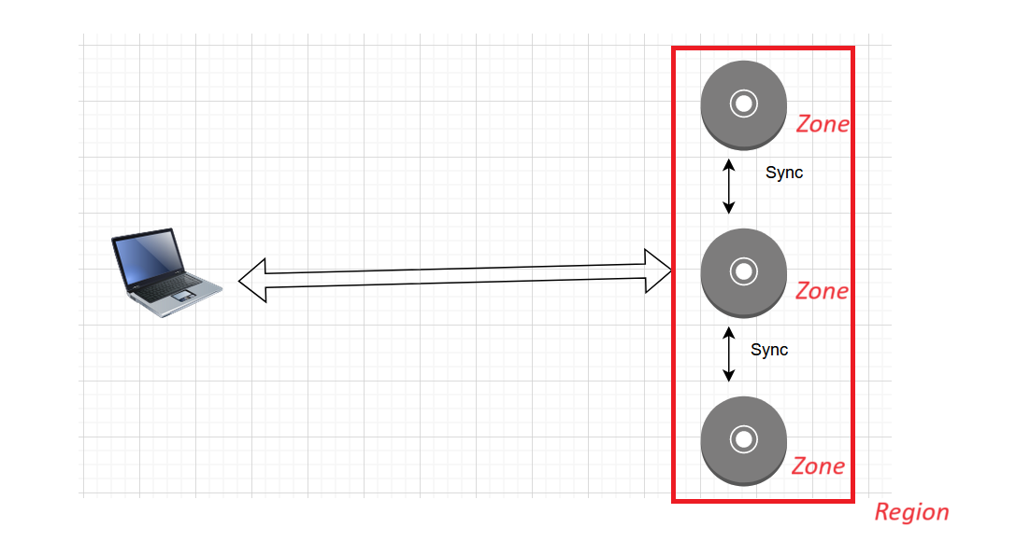
Now related the terminology

Slide 28
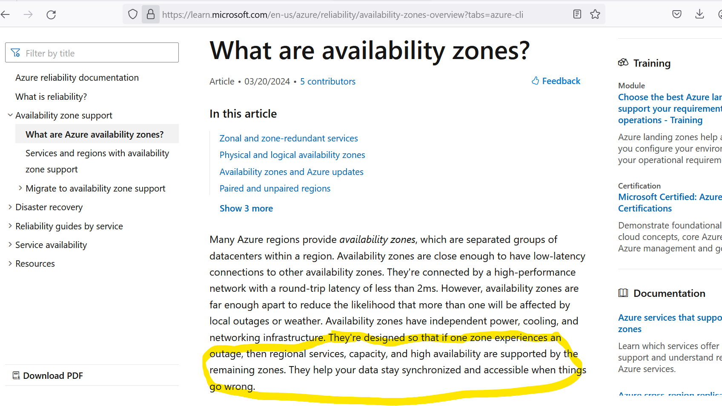
https://learn.microsoft.com/en-us/azure/reliability/availability-zones-overview?tabs=azure-cli

Slide 29
Demo
Login to console, and see regions for both Amazon and Azure

